Slide 1
EXECUTIVE DEVELOPMENT

Slide 2
Introduction
The basic purpose of executive development is to improve managerial performance by imparting knowledge, changing attitudes or increasing skills. Training certainly helps in improving job-related skills but when the intent is to enhance executives’ ability to handle diverse jobs and prepare them for future challenges the focus must shift to executive development.

Slide 3
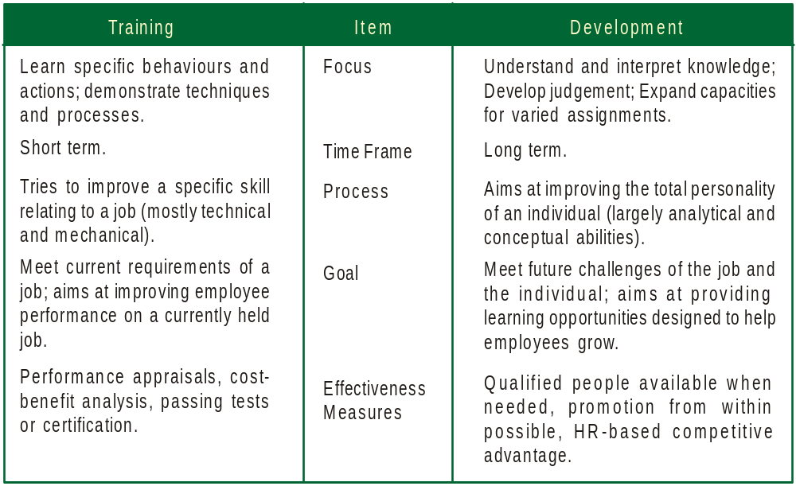
Training vs. executive development

Slide 4
Features of executive development
It is a planned effort to improve executives’ ability to handle a variety of assignments
It is not a one-shot deal, but a continuous, ongoing activity
It aims at improving the total personality of an executive
It aims at meeting future needs unlike training, which seeks to meet current needs
It is a long term process, as managers take time to acquire and improve their capabilities
It is proactive in nature as it focuses attention on the present as well as future requirements of both the organisation and the individual

Slide 5
Importance of executive development
Invaluable investment in the long run as it helps managers to acquire requisite knowledge, skills and abilities needed to handle complex situations in business
Enables executives to realise their own career goals and aspirations
Helps executives to step into superior positions easily
Assists executives in enhancing their people-management skills, taking a holistic view of various problems.

Slide 6
Executive Development Programmes: Steps
Steps in the organisation of an executive development programme
Analysis of organisational development needs
Appraisal of present managerial capabilities
Inventory of executive talent (in terms of age, service, education, experience etc
Planning of individual development programmes
Devising appropriate development programmes
Evaluating results

Slide 7
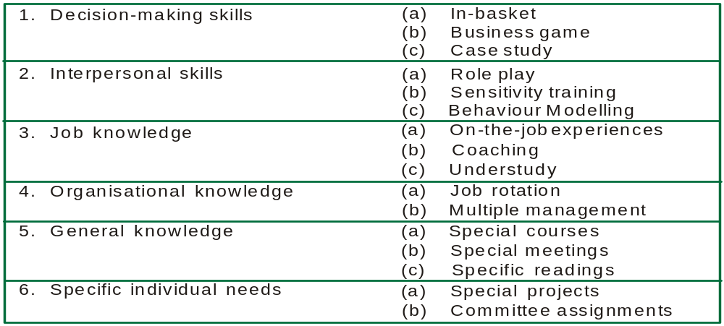
Methods/techniques
Various methods are employed to develop managerial skills and knowledge, such as:
Methods of executive development

Slide 8
In-basket: The trainee is asked to look into a number of papers such as memoranda, reports, telephone messages that typically confront a manager and respond appropriately.
+Trainees learn quickly, as they have to do everything within a time frame
+Creates healthy competition between participants allows them to grow
-The method is somewhat academic and removed from real life situations.
-Participants rarely respond to such imaginary situations in an enthusiastic manner

Slide 9
Case-study: The participant is asked to take up a simulated business problem and take appropriate decisions.
When is a case study most appropriate?
When the problem requires problem solving, thinking skills
The KSAs are complex and participants need time to master them
Active participation is required
The process of learning is as important as the content
Tem problem solving and interaction are possible.

Slide 10
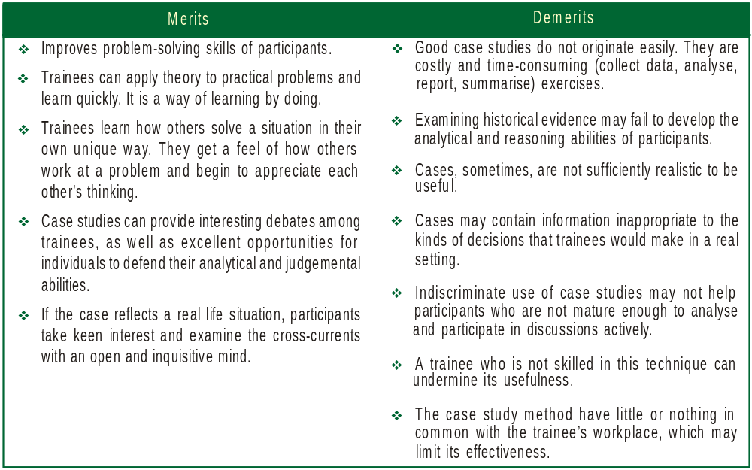
Merits and demerits of the case study method

Slide 11
When using case studies
Be clear about learning objectives and explore possible ways to realise the objectives
Decide which objectives would be best served by the case method
Find out the available cases that might work or consider developing your own
Set up the activity – including the case material, the room and the schedule
Observe the principles that guide effective group interactions
Provide an opportunity to all trainees to participate meaningfully and try to keep the groups small.
Stop for process checks and get set to intervene when interactions go out of hand
Allow for different learning styles
Clarify the trainer's role as a facilitator
Bridge the gap between theory and practice

Slide 12
Business games: It is a learning exercise representing a real-life situation where trainees compete with each other to achieve specific objectives.

Slide 13
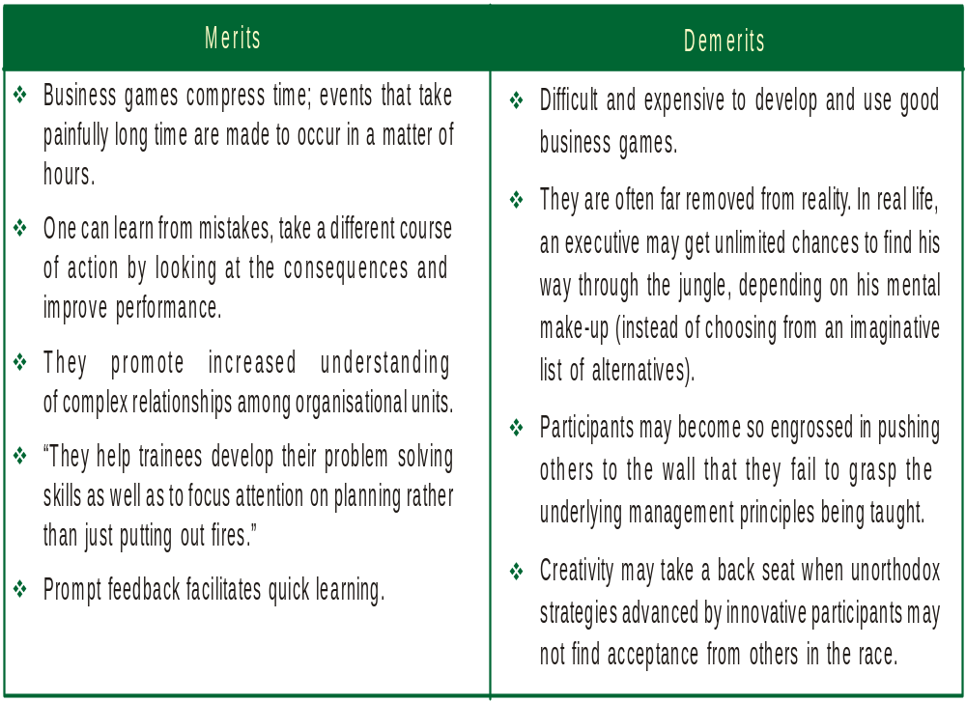
Merits and demerits of the business game method

Slide 14
Role play: This is a technique that requires the trainee to assume different identities to learn how others feel under different circumstances
Participants develop interpersonal skills
+ They learn by doing things actually
+ The competitive environment compels participants to listen, observe, analyse and improve their own performance by exploiting their potential fully
__lack of realism in this method comes in the way of enthusiastic participation
--not easy to duplicate the pressures and realities of actual decision making
--most trainees may not be very comfortable in role playing situations

Slide 15
Trainer’s responsibilities in role playing situations
Ensure that members of a role playing group get along with each other
Select and prepare the participants by introducing a specific situation
Ask participants to actually come out with potential characters
Realise that volunteers make better role players
Prepare observers by giving them specific tasks such as evaluation, feedback etc.
Guide the role play enactment over its bumps, since it is not scripted
Keep it short
Discuss the enactment and prepare bulleted points of what was learned

Slide 16
Sensitivity training: This is a method of changing behaviour through unstructured group interaction. (also known as T-group training, where T stands for training)
Features of T-group training
T-Group consists of 10-12 persons.
A leader acts as a catalyst and provides a free and open environment for discussion
There is no specified agenda
Members express their ideas, feelings and thoughts freely and openly
The focus is on behaviour rather than on duties
The aim is to achieve behaviour effectiveness in transactions with one's environment

Slide 17
Benefits
Participants gain rich experience in getting along with people
The exclusive focus on each others' behaviour helps participants to observe, analyse and then respond appropriately
Trainees can find out where they stand in comparison to others
The agenda less discussions encourages the participants to come out more openly and share their opinions with others
The opportunity to take charge of the group is always inherently present for the right candidate.

Slide 18
Costs
Considerable time is wasted in agenda-less, direction-less discussions
T-group leaders may lack the skills to instil enthusiasm and confidence in participants.
There is an immoral and unjustified invasion of privacy, based on false assumptions about the nature of human relationships at work.
The interchange of opinions in an open manner may be punished by superiors at a later stage, using some pretext or the other
T groups may actually destroy team learning and team spirit as they encourage participants to be hostile without feeling guilty during training.

Slide 19
On the job experience: This is a kind of class room learning where the trainee learns by actually doing things under the supervision of an experienced supervisor. Such methods are highly useful for certain groups like scientific and technical personnel
Behaviour modelling: This is an approach that demonstrates desired behaviour and gives trainees the chance to practice and role-play those behaviours and receive feedback.
Coaching: This is a development activity in which a supervisor plays an active role in imparting job knowledge and skills to the trainee. For effective coaching, a healthy and open relationship must exist between employees and their supervisors.

Slide 20
Merits and demerits of coaching
+Trainees learn quickly by actually doing a piece of work and obtain feedback
+Where the trainer and the trainee interact in an open manner, there is tremendous scope for the trainee to grow by seeking clarifications continuously and rectifying mistakes
__ A lot depends on the interpersonal skills of the supervisor
---The learner, often, cannot develop much beyond the limits of his own supervisor

Slide 21
Understudy: This is a development method wherein potential managers are given the chance to temporarily relieve an experienced manager of part of his job and act as his substitute during the period, giving him vital insights into the overall job that would make him the automatic choice in the succession process.
Job rotation: Moving a trainee from job to job so as to offer cross training is called job rotation. The idea behind this is to give managers the required diversified skills and a broader outlook.
Multiple management: It is a system in which permanent advisory committees of managers study problems of the company (thereby gaining first hand experience of various important aspects of business) and make recommendations to higher management.

Slide 22
Special courses, meetings, readings: In addition to the above, managers could also benefit by attending workshops organised by academic institutions, attending special meetings organised by various government and voluntary organisations and by reading specific articles relevant to their respective fields.
Special projects: In this method, a trainee is put on a project closely related to the objectives of the department.
Committee assignment: In this method, an adhoc committee is appointed to discuss, evaluate and offer suggestions relating to an important aspect of business.
Conferences: A conference is a meeting of people to discuss a subject of common interest. The participants exchange notes, opinions and ideas on the subject in a systematic and planned manner

Slide 23
Lectures: Lectures are formal presentations on a topic by an experienced and knowledgeable person. The presentation is generally supported by discussions, case studies, audio-visual aids and film shows.
Group discussion: In this method, papers are presented by two or three trainees on a selected topic, followed by thought- provoking discussions.
Programmed instruction: This is a learner-oriented technique which presents subject matter to the trainees in small sequential steps requiring frequent responses from the trainee and immediately offering him of their accuracy or otherwise.

Slide 24
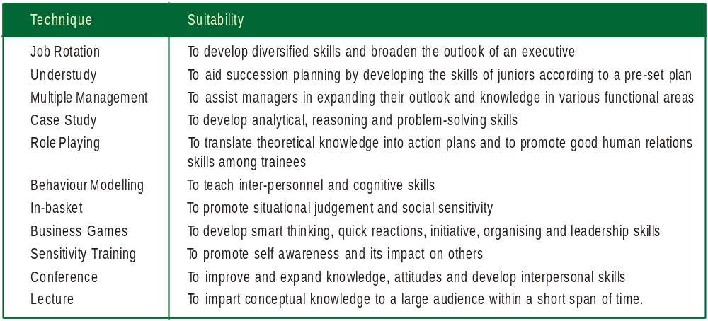
Selection Of A Suitable Method
While choosing a specific method, the following guidelines might be kept in mind
Suitability of executive development techniques

